Slide 1



1/9/2019 Meeting:
Pines Charter NEHS

Slide 2

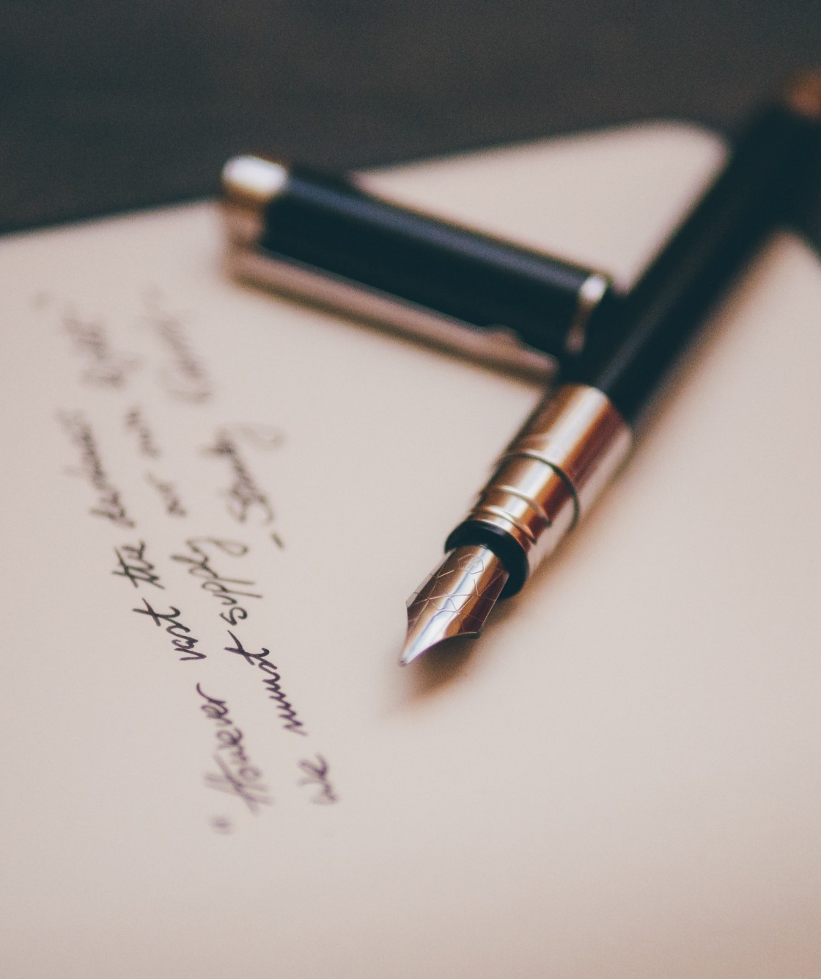

Happy New Year!
-Your NEHS advisor & officers :)

Slide 3



Stay Informed!
pinescharternehs@gmail.com
@pcnehs2018 to number 81010
Make SURE you are receiving emails and reminds from NEHS. If there is an issue please make sure to see Swati or Ara after the meeting.
@pinescharternehs

Slide 4
NEHS Requirements
15 hours required per year for all members
  For new members, at least 12 of those 15 must be completed by FEB.
  Seniors who don’t meet the hour requirement will not be eligible to purchase an NEHS cord for graduation.
  Participate in the Poetry Slam (see slide 7) & Poem in your Pocket Day!
  Seniors: earn 5 NEHS hours (& over $1000) by applying for the Common Reader Scholarship (read book & submit essay (850 wd max. See slide 5).
  Donate to Children’s Harbor or the Reading Program
  General meetings count as an hour
  A maximum of 7 hours can be earned through donations.
Remember, both your English and CUM GPA must stay at a 3.0 or higher
If you have not paid your dues by now, we’re sorry, but you cannot maintain membership.

Slide 5
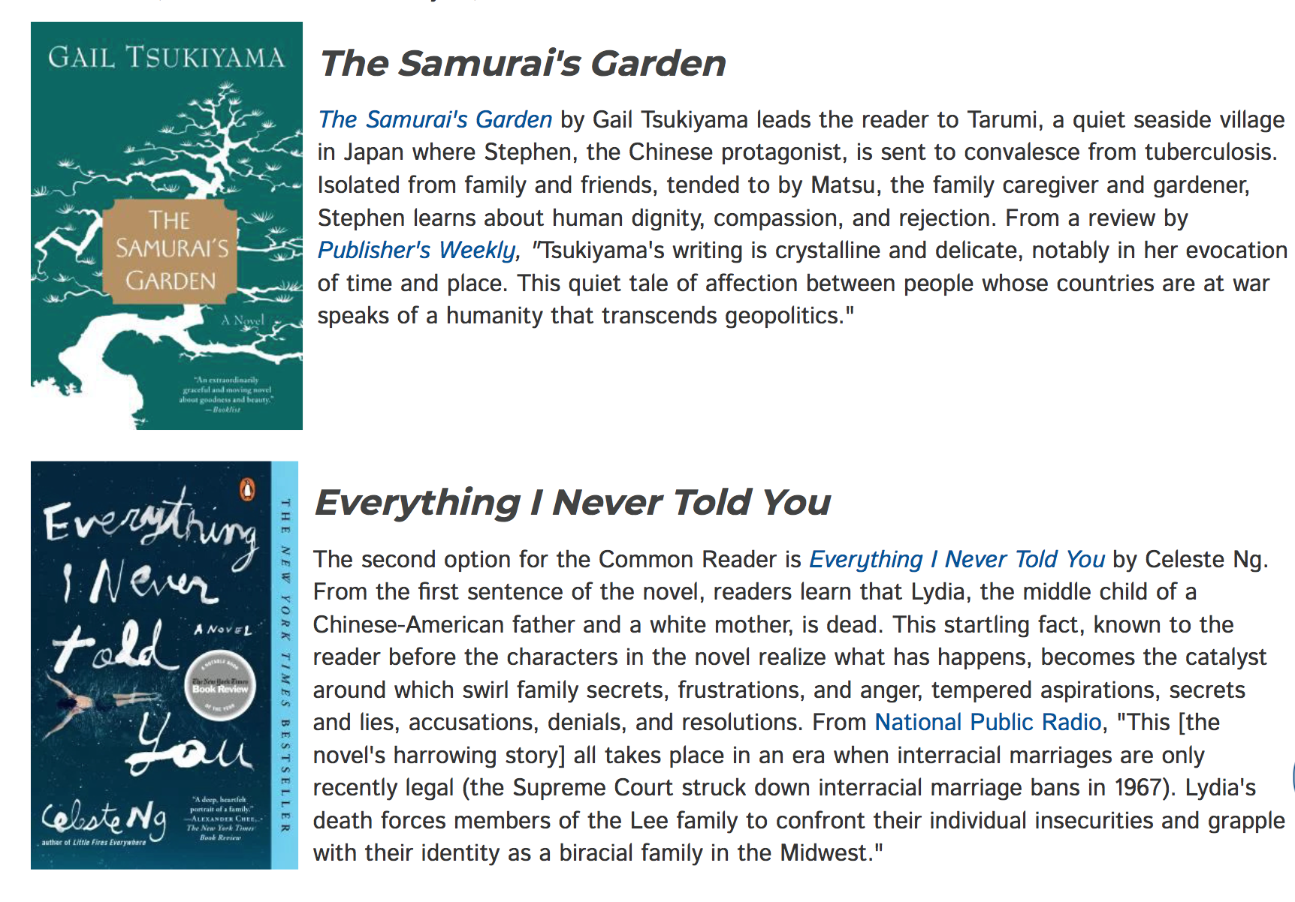
SENIORS! Earn $1000 or more AND 5 NEHS hours!
*Read one of these books & submit a 3 pg (only 850 word) essay to NEHS.
*Find guidelines, prompts, and submission link here.
*Deadline is Jan. 14th.
*After submitting, send copy of essay and proof of submission to me for 5 NEHS hours.

Slide 6
Juniors! Earn an NEHS Junior Summer Award!
The Junior Summer Study Award is presented to members of NEHS who are high school juniors, rising to the senior class in fall 2019. This award is intended to support students who have been selected for or who will be attending a summer learning program that is related to English studies in a direct way. Up to two awards for $750 will be offered each year.
Here is a link to the website for more information and criteria regarding the scholarship. http://www.nehs.us/scholarships-awards/student-awards/junior-study.shtml

Slide 7
January Contests: Poetry
There are FOURTEEN different categories to which you can submit!
Please see detailed flyer outside D203 for detailed descriptions of each category
I will also send the flyer via email
Submissions due before January 30th
The winner of each category will…
  Earn a $10 gift card
  Represent our school at the Broward County Literary Fair
  Be announced at the Poetry Slam
ShrinkLit
Sonnet
Spoken Word
Villanelle
Cinquain
Ekphrastic Poem
Free Verse
Haiku
Ode
Parody Poem
Poetry Interpretation
Poem for Two Voices
Rhymed Verse
Sestina

Slide 8

AROUND THE CORNER: Our NEHS Poetry Slam!
February 6th
  5:00-7:30 pm in the library auditorium
  save the date now!!!
Showcases original student poetry
Spoken word contest
Poetry Out Loud Recitation Competition
Announcement of Literary contest winners
ALL MEMBERS should attend and bring friends and family!
Earn NEHS hours! (see next slide)
Write and share a poem on stage!
  Submit your poem to Ms. Phelps before January 30th.

Slide 9
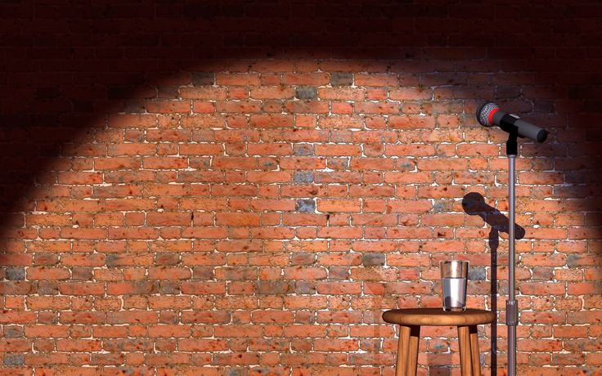

All members should attend --
and bring friends!
Sign up to...
-make banners and decor
-donate cookies, plates, napkins
-set-up for the event
-serve food at the event
-clean up
-read a poem!!!

Slide 10
LITERACY NIGHT AT FSU ELEMENTARY!
Earn NEHS hours!
Event is on Friday, February 1st
Pines Charter FSU Elementary campus
Volunteers needed BEFORE, DURING, and AFTER the February 1st event.
Please email Mrs. Correa to sign up and get further details!
palonso@pinescharter.net

Slide 11

Kinder Reading Program Update
If for some reason you have not turned in your student evaluation sheets, please see Swati ASAP! All student evaluation sheets should be turned in by the end of this week.

Slide 12


DONATE LEVEL 1 READERS for NEHS hours
(you can earn up to 7 of your 15 required hours through donations)

Slide 13
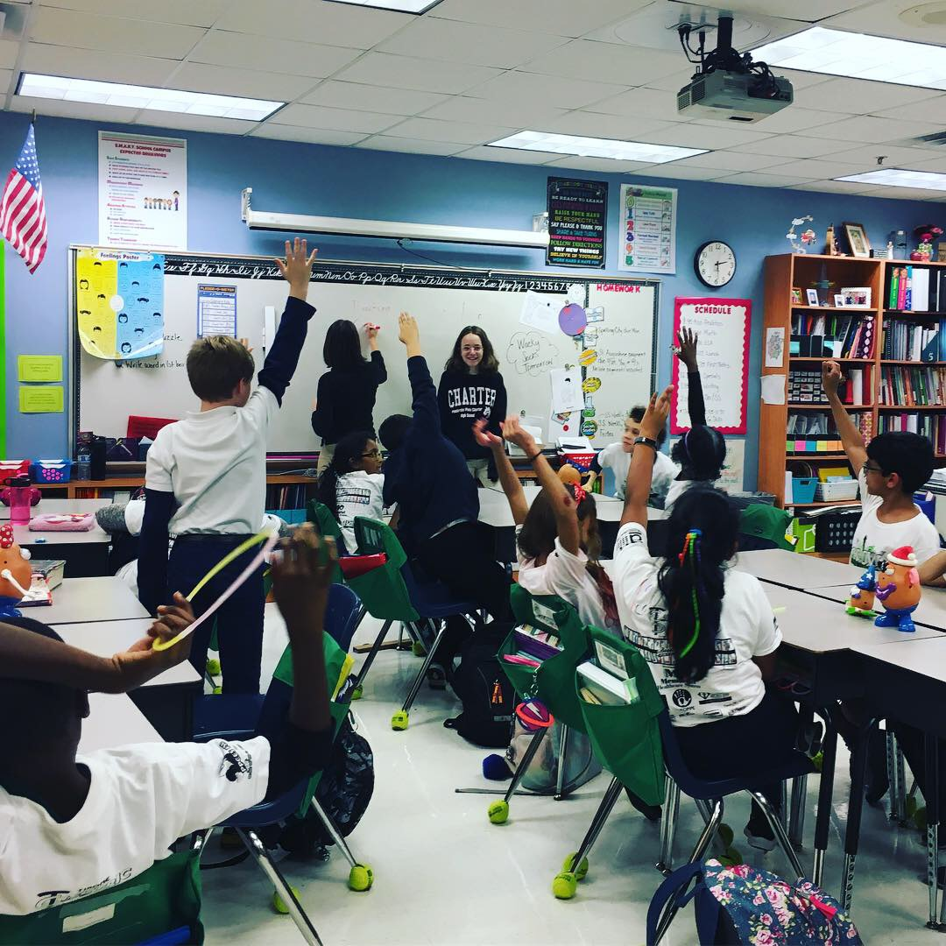
Debate Mentorship Program is a Success!
Our NEHS debate mentors have been having great visits with Ms. Coleman’s 4th grade class! The kids are super excited to have our mentors model debates, lead lessons, and teach them new skills!

Slide 14

Children’s Harbor Outreach Project
We’re also still collecting writing supplies for disadvantaged children
Can earn up to 7 volunteer/NEHS hours through donations
What is needed?
  bring in spiral notebooks, composition books, packs of lined paper, construction paper, packs of pens and pencils…

Slide 15


NinjaLit!
A new project in-the-making!
We will be hiding laminated literary quotes in various places around the school
  (in class novels, textbooks, shelves etc.)
Let’s spread our enthusiasm about literature, have fun, and brighten people’s days!
  Anyone who finds a quote will take a picture with it and DM us the picture to our instagram.
  We will be posting these pictures! #NEHSNinjaLit
We’ll begin our work in earnest after the Poetry Slam
This is great way to get your hours!
  Receive 15 minutes for every USABLE quote you submit (8 quotes/2 hours max).
  Must be from literature (play, novel, memoir, etc.)(no political /insulting quotes)
  They can be funny, witty, inspiring, etc. (but never disparaging).
We will start laminating quotes after the Poetry Slam!

Slide 16

Reminders...
Make sure you signed in so you can receive your hour
Check pinescharternehs.wordpress.com for info
Please follow us on instagram @pinescharternehs
Next General Meeting: February 13

