Slide 1



12/11/2018 Meeting:
Pines Charter NEHS

Slide 2



Stay Informed!
pinescharternehs@gmail.com
@pcnehs2018 to number 81010
Make sure you are receiving emails and reminds from NEHS. If there is an issue please make sure to see Swati or Ara after the meeting.
@pinescharternehs

Slide 3
NEHS Requirements
15 hours required per year for all members
  For new members, at least 12 of those 15 must be completed by FEB.
  Seniors who don’t meet the hour requirement will not be eligible to purchase an NEHS cord for graduation.
  Participate in the Poetry Slam & Poem in your Pocket Day!
  Seniors: earn 5 NEHS hours (& over $1000) by applying for the Common Reader Scholarship (read book & submit essay (850 wd max. See slide 6).
  Donate to Children’s Harbor or the Reading Program
  General meetings count as an hour
  A maximum of 7 hours can be earned through donations.
Remember, both your English and CUM GPA must stay at a 3.0 or higher

Slide 4



Recite Night!
Thank you to all our members who performed, helped out, and attended our 2018 Recite Night!
We hope it was an enjoyable experience for you!
Congratulations to our Poetry Out Loud Finalists!
-Ara Johnson -Swati Kumar -Naveen Farook
-Ariana Arvelo -Cristina Arguelles -Riley Gonzalez
-Ava Johnson -Kenneth Martinez -Sofia Cano
-Jessica Schwend

Slide 5
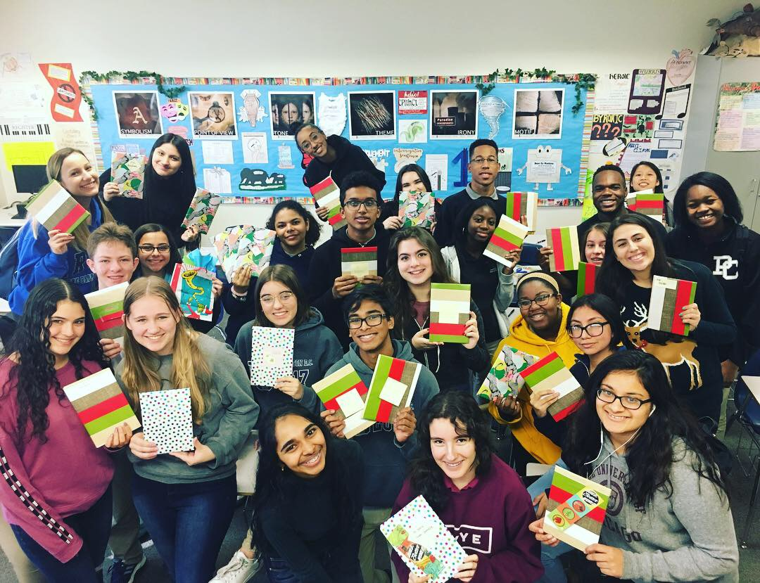
Kinder Reading Program Update
We distributed books as gifts to the kindergartners yesterday!
There will be no visit to the FSU campus next week (12/18) due to midterms week!
If for some reason you have not turned in your student evaluation sheets, please see Swati!

Slide 6
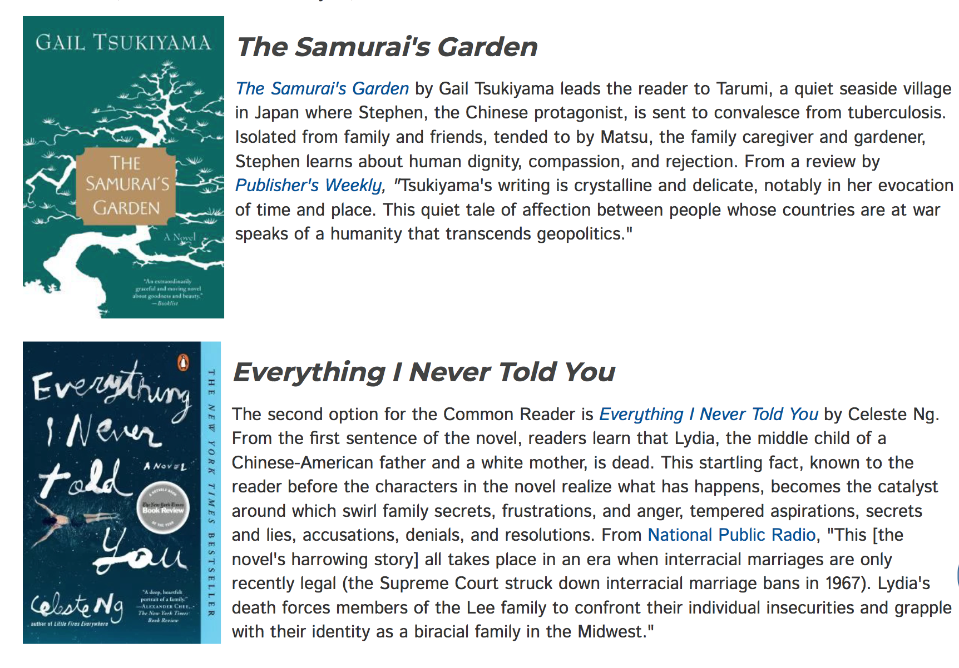
SENIORS! Earn $1000 or more AND 5 NEHS hours!
*Read one of these books & submit a 3 pg (850 word) essay to NEHS.
*Find guidelines, prompts, and submission link here.
*Deadline is Jan. 14th.
*After submitting, send copy of essay and proof of submission to me for 5 NEHS hours.

Slide 7
December Literary Contest...
Enter PPCHS’S SCENE-WRITING Contest
by submitting an original, typed script*
to Ms. Phelps in D203 by Tuesday, January 8th.
The winning student will:
-represent PPCHS in the Broward County Literary Fair
-win a $10 gift card.
-be announced at the Poetry Slam on February 6th.
*GUIDELINES: Your script must…
• contain dialogue, a minimum of two characters, and stage directions
• include a title page, a second page that lists characters and gives a brief synopsis and any other information relevant to understanding, and up to ten successive pages that contain the actual text of the play
• be typed, using double-spaced, size 12 Times New Roman font

Slide 8


NinjaLit!
A new project in-the-making!
We will be hiding laminated literary quotes in various places around the school
  (in class novels, textbooks, shelves etc.)
Let’s spread our enthusiasm about literature, have fun, and brighten people’s days!
  Anyone who finds a quote will take a picture with it and DM us the picture to our instagram.
  We will be posting these pictures! #NEHSNinjaLit
This is great way to get your hours!
  You will receive 15 minutes for every USABLE quote you submit (8 quotes/2 hours max).
  Must be from literature (play, novel, memoir, etc.)(no political/historical/insulting quotes)
    They can be funny, witty, inspiring, etc. (but never disparaging).

Slide 9

Coming soon: annual NEHS Poetry Slam!
February 6th
  5:00-7:15 pm
  library auditorium
  save the date now!!!
Showcases originally written poetry readings/performances
Spoken word contest
Poetry Out Loud Recitation Competition
Announcement of Literary contest winners
Participate!
  as performer
  as NEHS volunteer
  Get NEHS hours!

Slide 10

Reminders...
Make sure you signed in so you can receive your hour
Check pinescharternehs.wordpress.com for info
Please follow us on instagram @pinescharternehs
Next General Meeting: Wednesday, January 9th

Slide 11

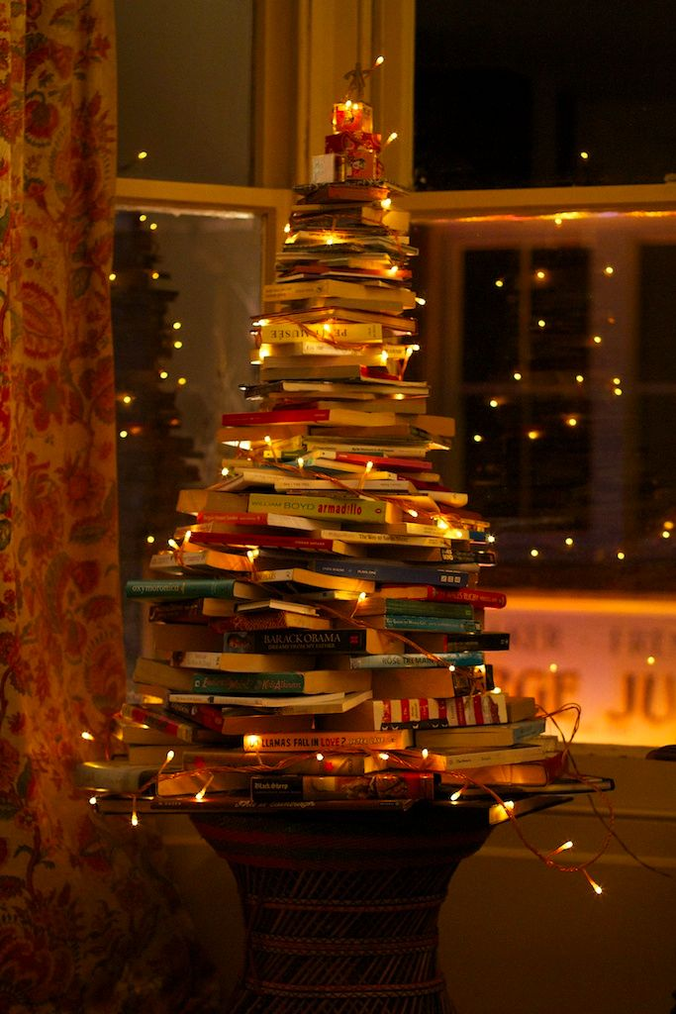
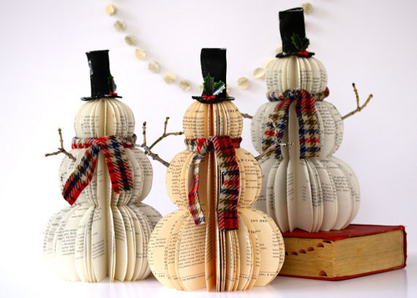
Have a great winter break!
<3 Your NEHS advisor & officers

