Slide 1



11/14/2018 Meeting:
Pines Charter NEHS

Slide 2



Stay Informed!
pinescharternehs@gmail.com
@pcnehs2018 to number 81010
Make sure you are receiving emails and reminds from NEHS. If there is an issue please make sure to see Swati or Ara after the meeting.
@pinescharternehs

Slide 3
NEHS Requirements
15 hours required per year for all members
  For new members, at least 12 of those 15 must be completed by FEB.
  Help plan and promote events
    Help to plan, attend, and participate in our big events...
      Recite Night, Poetry Slam, and Poem in your Pocket Day!
    Help out with our new NinjaLit Project!
    Donate to Children’s Harbor (supplies) or to the Reading Program (books/games)
    General meetings count as an hour
  A maximum of 7 hours can be earned through donations.
Remember, both your English and CUM GPA must stay at a 3.0 or higher

Slide 4


Recite Night!
November 30th, 2:15pm in Ms. Schwab’s room
Starry Night themed
Earn hours for helping with decor and promotion
Earn hours for setting up on the 28th and 29th
Recite Night is recitation only (published poetry, etc.)
Will be qualifying round to select top 10 finalists to compete in our Poetry Out Loud Competition at our annual NEHS Poetry Slam on February 6th in the Library Auditorium.

Slide 5

Recite Night
We will need:
Decorations
  Come after school to D203 this week or next to help us cut stars and paper bags for tea lights.
  Help us set up in Ms. Schwab’s room on the 28th and 29th after school.
Promotion
  Help us distribute Recite Night flyers in D building and spread the word around.
Volunteers during the actual event
Supporters for our performers!
Donations (please bring 26th-29th):
  store-bought cookies (from aisle, not from deli)
    chocolate chip
    white chocolate macadamia
    sugar cookies
    snickerdoodle
  milk
    whole milk
    chocolate milk
    almond milk
    soy milk
  napkins

Slide 6

Kinder Reading Program Update
We will be having a homeroom meeting on Tuesday, November 20th in D203.
Don’t forget that this is a weekly Tuesday commitment except in cases of illness or verifiable emergency. Meetings and test make-ups cannot be used as excuses. Your kinder reader is waiting for you.
Only 1 excused absence is allowed per semester!

Slide 7


DONATE LEVEL 1 READERS for NEHS hours
(you can earn up to 7 of your 15 required hours through donations)

Slide 8
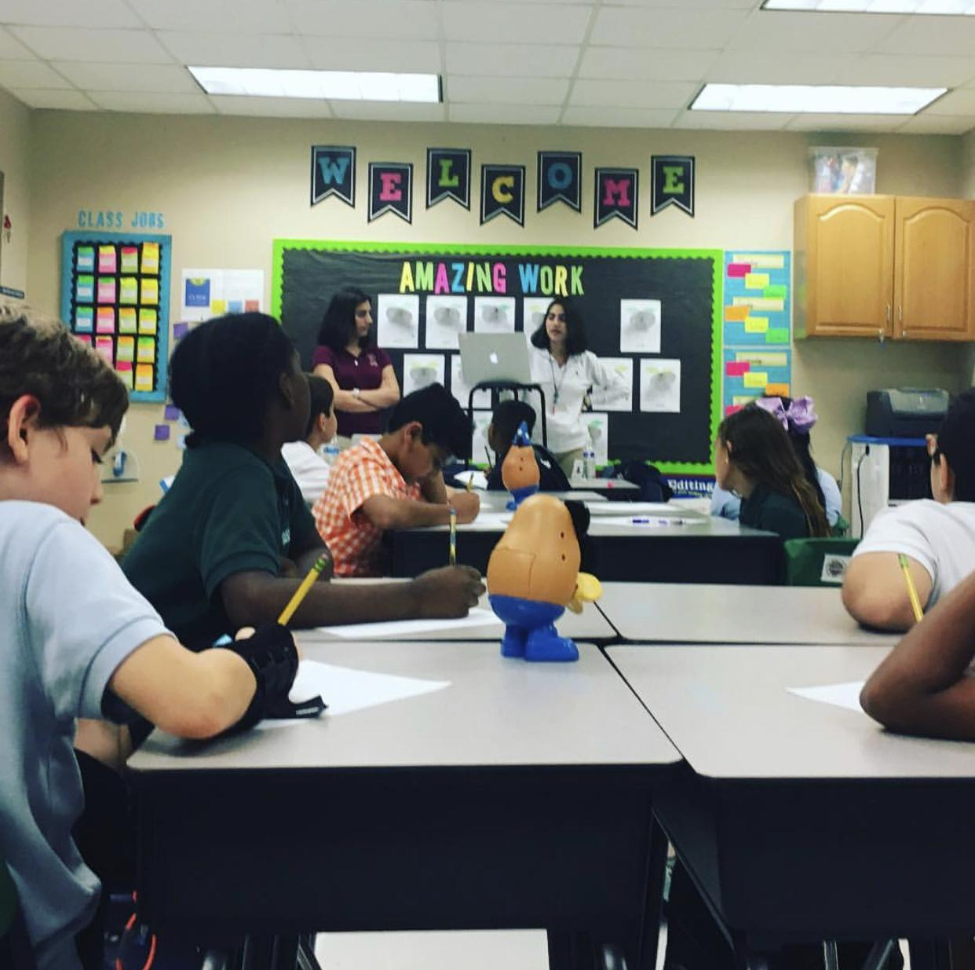

Debate Mentorship Program is underway!
We started last week with our Thursday visits to Mrs. Coleman’s 4th grade classroom at the PPCES-FSU campus!

Slide 9

Children’s Harbor Outreach Project
We’re also still collecting writing supplies for disadvantaged children
Can earn up to 7 volunteer/NEHS hours through donations
What is needed?
  bring in spiral notebooks, composition books, packs of lined paper, construction paper, packs of pens and pencils…

Slide 10


NinjaLit!
A new project in-the-making!
We will be hiding laminated literary quotes in various places around the school
  (in class novels, textbooks, shelves etc.)
Let’s spread our enthusiasm about literature, have fun, and brighten people’s days!
  Anyone who finds a quote will take a picture with it and DM us the picture to our instagram.
  We will be posting these pictures! #NEHSNinjaLit
This is great way to get your hours!
  You will receive 15 minutes for every USABLE quote you submit (8 quotes/2 hours max).
  Must be from literature (play, novel, memoir, etc.)(no political/historical/insulting quotes)
    They can be funny, witty, inspiring, etc. (but never disparaging).

Slide 11

November Literary Contests...
PPCHS SHORT STORY CONTEST
  Submit a 4-10 pg. original story to D203 by end of November
  Winner will...
    represent PPCHS in 2018 Broward County Literary Fair
    be announced at this year’s NEHS Poetry Slam
    receive a $10 Barnes and Noble gift card
BROWARD COUNTY LIBRARY FOUNDATION SHORT STORY CONTEST
  Write an original short story that explores a dystopian United States not run by a democracy
  All stories must be NO LONGER THAN 1500 words
  Stories should be titled, double-spaced, single-sided, & typed using Times New Roman 12 font
  DO NOT PUT YOUR NAME (or the school’s) on your TWO submitted copies
  $$ for 3 WINNERS PER SCHOOL! 1st place: $75; 2nd place: $50; 3rd place: $50
  Please hand-deliver TWO copies to Ms. Sarah Phelps in D203 by Monday, Dec. 3rd

Slide 12

NEHS Scholarship money opportunity for seniors!
This year, NEHS seniors should read one of the NEHS Common Readers to apply for merit-based scholarships before January 16th.
The two options are The Samurai’s Garden by Gail Tsukiyama & Everything I Never Told You by Celeste Ng.
(summaries from nehs.us) More information can be found on the NEHS National website.

Slide 13



Holiday Elephant Book Exchange!
Will take place during our December meeting!
Submit a new book and receive a new book
Each book should be wrapped but have a short synopsis on the front
On the day of the exchange, everyone is given a number and would have an opportunity to pick a new book
Similar rules to elephant gift exchange
Refreshments will be provided
Date: December 12th

Slide 14

Reminders...
Make sure you signed in so you can receive your hour
Check pinescharternehs.wordpress.com for info
Follow us on instagram @pinescharternehs
Help us prepare for Recite Night!
Come to Recite Night on November 30th!
Next General Meeting: Wednesday, December 12th

Slide 15
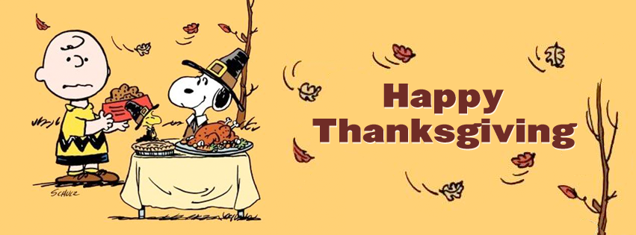
We are so thankful for all our wonderful NEHS members!

