Slide 1



10/17/2018 Meeting:
Pines Charter NEHS

Slide 2



Stay Informed!
pinescharternehs@gmail.com
@pcnehs2018 to number 81010
Make sure you are receiving emails and reminds from NEHS. If there is an issue please make sure to see Swati or Ara after the meeting.
@pinescharternehs

Slide 3

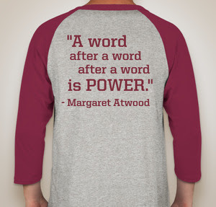

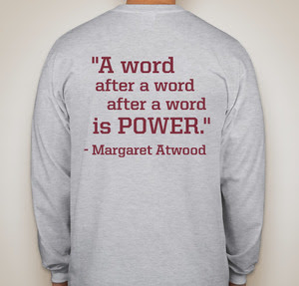
NEHS club T-shirts are in!
See us after the meeting to pick up your T-shirts!
You will need them for picture day!

Slide 4

Club Picture Day!
Tuesday, October 23rd
Make sure you collect your passes to get out of class
Our pictures are at 8:00am in the gym, so leave class at 7:55.
Please wear our 2018 NEHS shirts!

Slide 5
NEHS Requirements
15 hours required per year for all members
  For new members, at least 12 of those 15 must be completed by FEB.
  Help plan and promote events
    Attend and participate in events such as Recite Night, Poetry Slam, and Poem in your Pocket Day!
    Join our Speech/Debate mentor Program
    Help out with our new NinjaLit Project!
    Donate to Children’s Harbor (supplies) or to the Reading Program (books/games)
    General meetings count as an hour
  A maximum of 7 hours can be earned through donations.
Remember, both your English and CUM GPA must stay at a 3.0 or higher

Slide 6
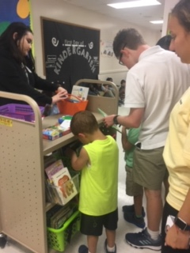
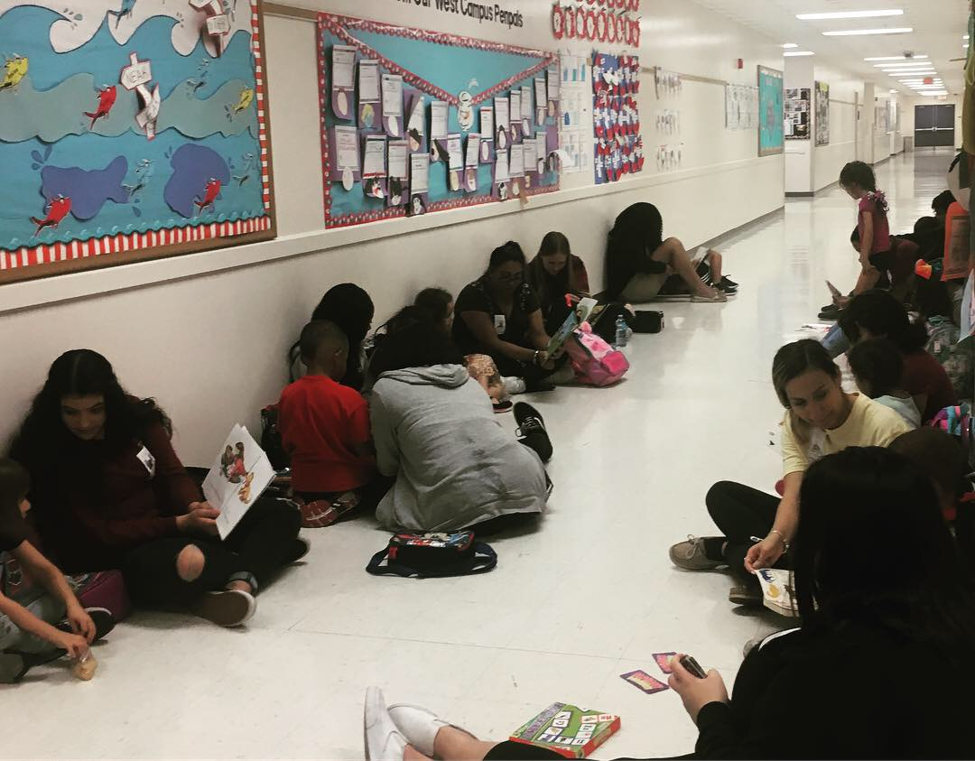

Kinder Reading Program is underway!
Don’t forget that this is a weekly Tuesday Commitment except in cases of illness or verifiable emergency. Meetings and test make-ups cannot be used as excuses. Your kinder reader is waiting for you.

Slide 7


DONATE LEVEL 1 READERS for NEHS hours
(you can earn up to 7 of your 15 required hours through donations)

Slide 8

Children’s Harbor Outreach Project
We’re also still collecting writing supplies for disadvantaged children
Can earn up to 7 volunteer/NEHS hours through donations
What is needed?
  bring in spiral notebooks, composition books, packs of lined paper, construction paper, packs of pens and pencils…

Slide 9
NEW Speech & Debate Mentorship Program
Will involve after-school visits to a 4th grade gifted classroom at the Pines-FSU Elementary
  The FSU visits will be on a Tuesday or Thursday
  Looking for people with debate experience
Will likely focus on Congress, Oral Interp, and Original Oratory
Interested? Email us at pinescharternehs@gmail.com

Slide 10


NinjaLit!
Our newest project!
We will be hiding laminated literary quotes in various places around the school
  (in class novels, textbooks, shelves etc.)
Let’s spread our enthusiasm about literature, have fun, and brighten people’s days!
  Anyone who finds a quote will take a picture with it and DM us the picture to our instagram.
  We will be posting these pictures! #NEHSNinjaLit
This is great way to get your hours!
  You will receive 15 minutes for every USABLE quote you submit (8 quotes/2 hours max).
  Must be from literature (play, novel, memoir, etc.)(no political/historical/insulting quotes)
    They can be funny, witty, inspiring, etc. (but never disparaging).

Slide 11
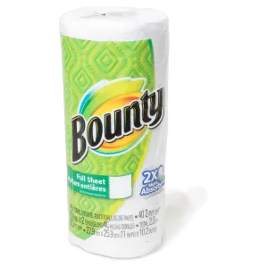

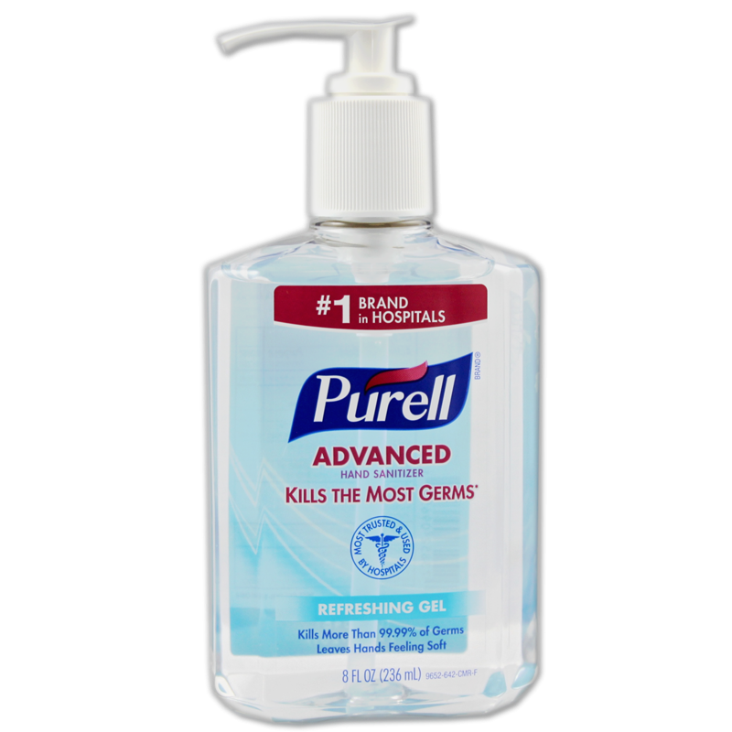
ISC Drive Coming Up!
This will be another opportunity for you to earn NEHS donation hours (maximum of 7).
Feminine products (all types) Deodorant Baby wipes (in lieu of shower as they have no running water) Paper towels Tylenol Emergen-c All baby supplies Bread Adult diapers (depends) Pet food Canned goods | Cleaning supplies Hand sanitizer Trash bags Bug spray Sunscreen Ziploc bags Little propane tanks Fix-a-flat First aid kit Gloves Baby wipes Toilet paper | Paper towels Bleach Prepared non-perishable goods Dried beans Gatorade Water Peanut butter, tuna, etc. Charcoal and lighters Batteries and flashlights Garbage bags - contractor grade Lighters

Slide 12
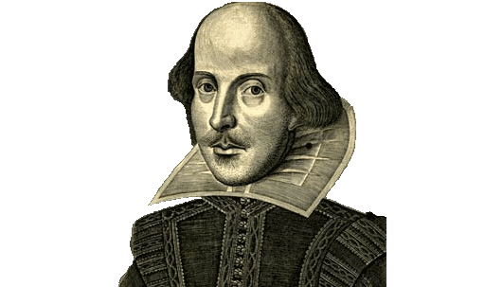

This Month’s Literary Contests...
Satirical Cartoon: a panel with punchline or dialogue at bottom
Literary Comic Strip: may be an original story or based on literary work
Classic Literature Book Cover: on a text by William Shakespeare
  Original blurb about author
  Title and brief summary
  Image to represent text
  reviews/quotations about text
  Original illustration only!
Submit all entries to Ms. Sarah Phelps in D203 by Friday, Nov. 2nd
Winners will:
  Represent PPCHS in 2018 Broward County Literary Fair
  Be announced at this year’s NEHS Poetry Slam
  Receive a $10 Barnes and Noble gift card

Slide 13

NEHS Scholarship money opportunity for seniors!
This year, NEHS seniors should read one of the NEHS Common Readers to apply for merit-based scholarships before January 16th.
The two options are The Samurai’s Garden by Gail Tsukiyama & Everything I Never Told You by Celeste Ng.
(summaries from nehs.us) More information can be found on the NEHS National website.

Slide 14

Recite Night!
November 30th, 2:15pm in Ms. Schwab’s room
Starry Night themed
Earn hours for setting up on the 28th and 29th
Recitation only
  published poetry, speeches, monologues, etc.
Good practice for Poetry Out Loud Competition

Slide 15



Recite Night
We will need help with:
Decorations
Promotional Banners
Donations:
  cookies!!!
  milk
  napkins
Volunteers
during the actual event
Participants!

Slide 16

  Visit poetryoutloud.org to select poems to perform at Recite Night on November 30th.
  Top ten finalists will compete again at this year’s NEHS Poetry Slam on February 6th!
  Our school winner goes forward to compete at the state level
  Each winner at the state level will receive $200 and an all-expenses-paid trip with an adult chaperone to Washington, DC, to compete in the National Finals.
  The National POL finalist is awarded $20,000!
  Attend informational meeting in D203 during HR on Tuesday, October 30th.

Slide 17

Annual NEHS 2019 Poetry Slam!
February 6th
  5:00-7:15 pm
  library auditorium
  save the date now!!!
Showcases originally written poetry readings/performances
Spoken word contest
Poetry Out Loud Recitation Competition
Announcement of Literary contest winners
Participate!
  as performer
  as NEHS volunteer
  Get NEHS hours!

Slide 18



Holiday Elephant Book Exchange!
Would be open to the whole school
Holiday themed
submit a new book and receive a new book
Each book would be wrapped but have a short synopsis on the front
On the day of the exchange, everyone is given a number and would have an opportunity to pick a new book
Similar rules to elephant gift exchange
Refreshments would be provided
Tentative Date: December 14th/16th

Slide 19

Reminders...
Make sure you signed in so you can receive your hour
Check pinescharternehs.wordpress.com for info
Sign up for Remind
Follow us on instagram!
Next General Meeting: Wednesday, November 14th
Email us if you’re interested in modeling debate at FSU Elementary.
Poetry Out Loud information meeting is November 30th during homeroom.

